Slide 1
MCB 545
Functional Genomics in Principle and Practice
Kevin Van Bortle
B521 CLSL
kvbortle@Illinois.edu
IGB 607
MW 10-11:20am

Slide 2
Course Registration

Slide 3
Introductions

Slide 4
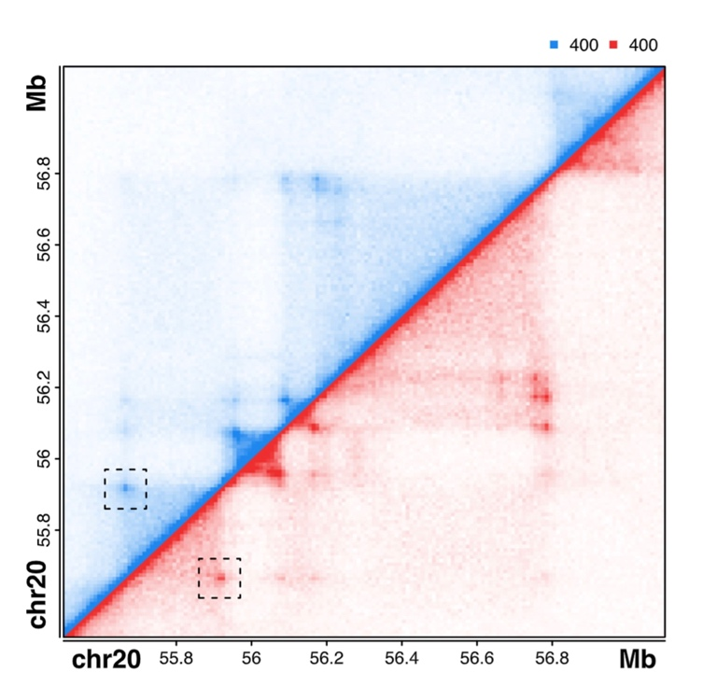
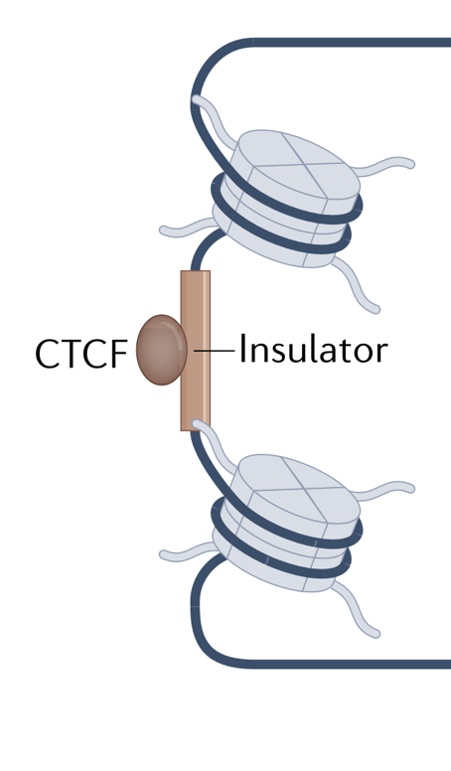
My background
insulator regulatory function (e.g. CTCF)
long-range
chromatin interactions
Pol III transcription,
small RNA function

Slide 5
Introductions

Slide 6
Week 1 (January 18th, 2023)
Intro to genomics; Course overview

Slide 7
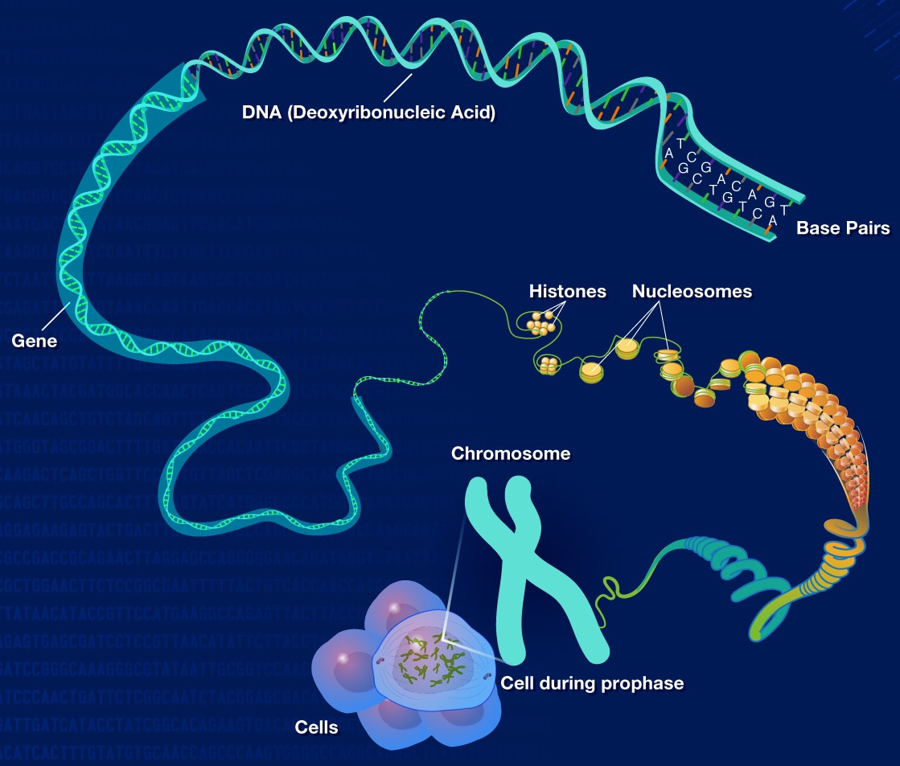
Genomics
Interdisciplinary field
structure, function, evolution,
mapping, editing[..] of genomes
the study of genes (and gene products), including interact-ions with other genes and with the environment
NHGRI (genome.gov)

Slide 8
Genomics
structural genomics
comparative genomics
functional genomics
pharmacogenomics
epigenomics
metagenomics
computational genomics

Slide 9
Functional genomics
Definitions
“the study of how genes and intergenic regions […] contribute to different biological processes” (EMBL)
“A branch that integrates molecular biology and cell biology studies, and deals with the whole structure, function, and regulation of gene in contrast to gene-by-gene approaches of classical molecular biology”
“the study of how the genome, transcripts, proteins, and metabolites work together to produce a particular phenotype”

Slide 10
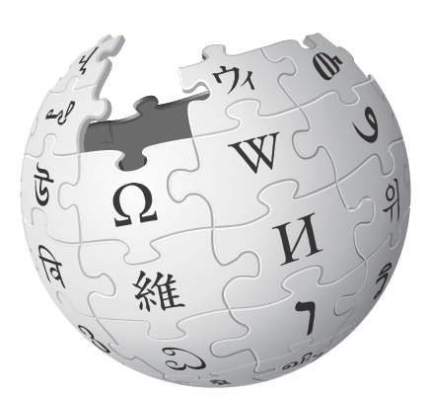
Functional genomics
Functional genomics is a field of molecular biology that attempts to describe gene (and protein) functions and interactions […] making use of vast data generated by genomic and transcriptomic projects. Functional genomics focuses on dynamic aspects such as gene transcription, translation, regulation of gene expression, and protein-protein interactions […] A key characteristic is the use of genome-wide approaches …
https://en.wikipedia.org/wiki/Functional_genomics

Slide 11
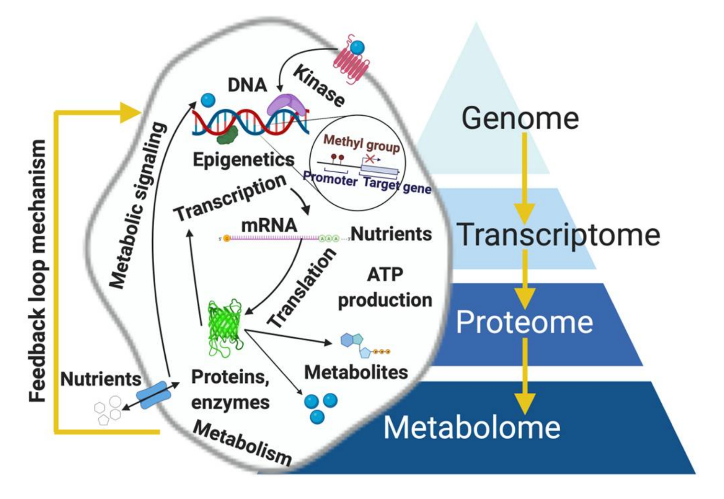
Genomes, Transcriptomes, Proteomes, Metabolomes
The flow of biological information: from genomic blueprint to cellular infra-structure and metabolism and back again
Resurreccion & Fong, 2022

Slide 12
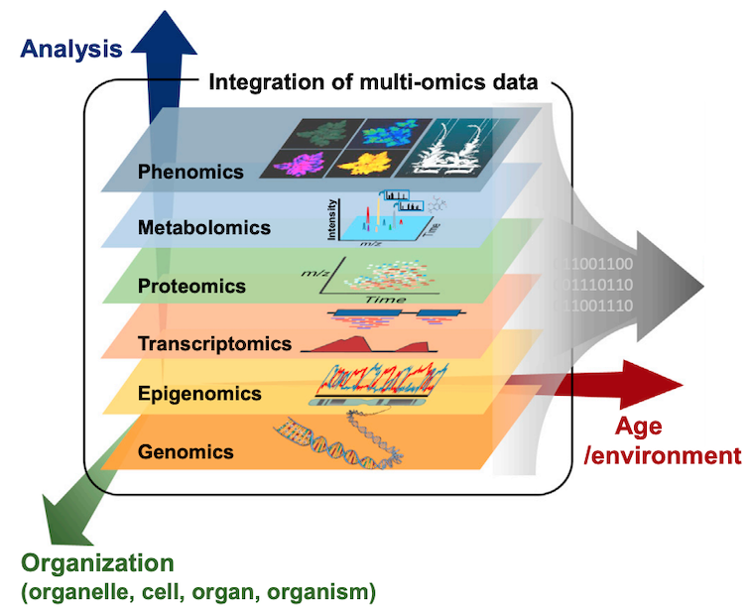
“omics”
High-throughput assays that comprehensively and simultaneously measure a particular molecule type
Kim, Woo, and Nam, 2016

Slide 13
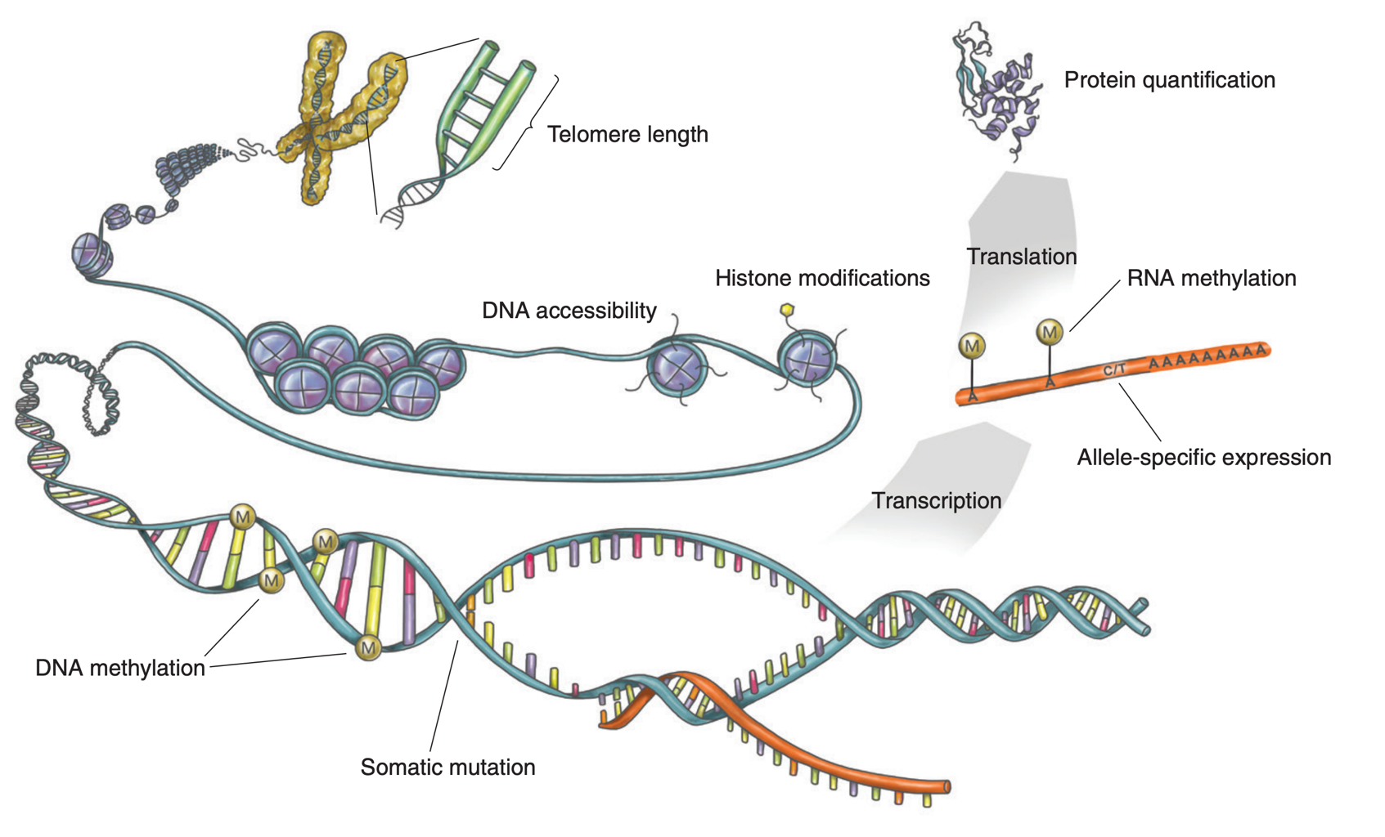
the many modalities of genome function
Integration of multi-omics data is needed to understand the cascade from genetic and disease-associated variants and tissue-specific regulatory mechanisms to molecular and cellular phenotypes
eGTEX, Nature, 2017

Slide 14
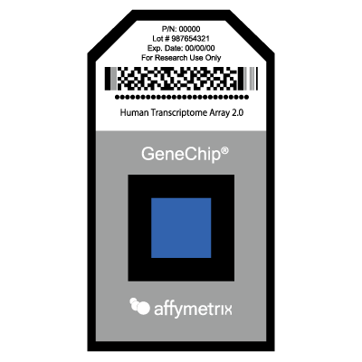
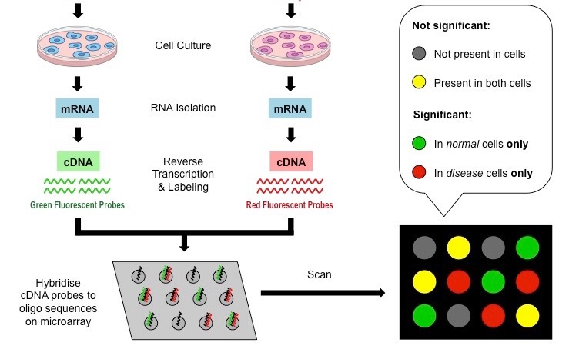
Genomics: DNA microarrays
Probe-target hybridization quantified by detection of labeled sample on solid surface oligo microarray
(DNA chip)
https://ib.bioninja.com.au/options/untitled/b4-medicine/dna-microarrays.html

Slide 15
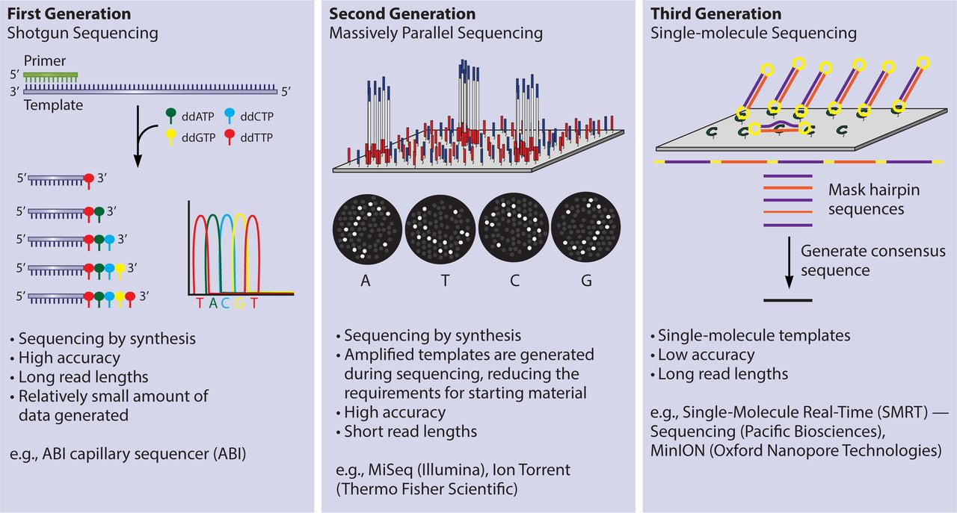
Genomics: DNA sequencing
Distinct advantages of first-, second-, & third- generation sequencing platforms
read length
throughput
accuracy
Ronholm et al., 2016

Slide 16
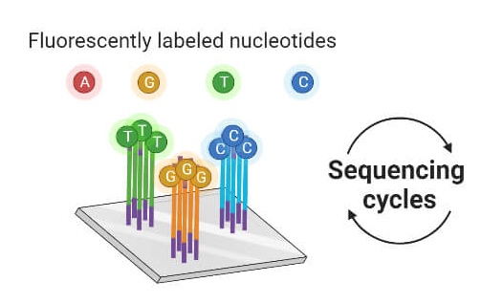
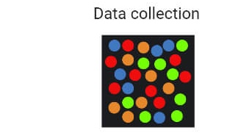
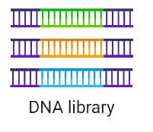
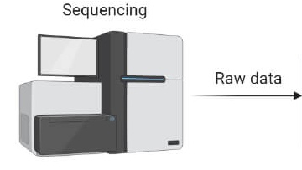
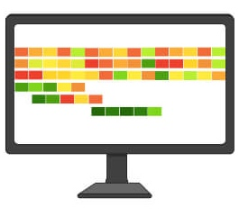
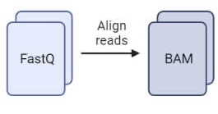
Genomics: from sequence to analysis
Receiving (or acquiring) sequencing data can be the beginning of a long, bioinformatic journey
data quality control
standard processing
standard “analysis”
custom analyses
integrated analyses
interpretation, hypothesis generation…
https://thebiologynotes.com/next-generation-sequencing-ngs/

Slide 17
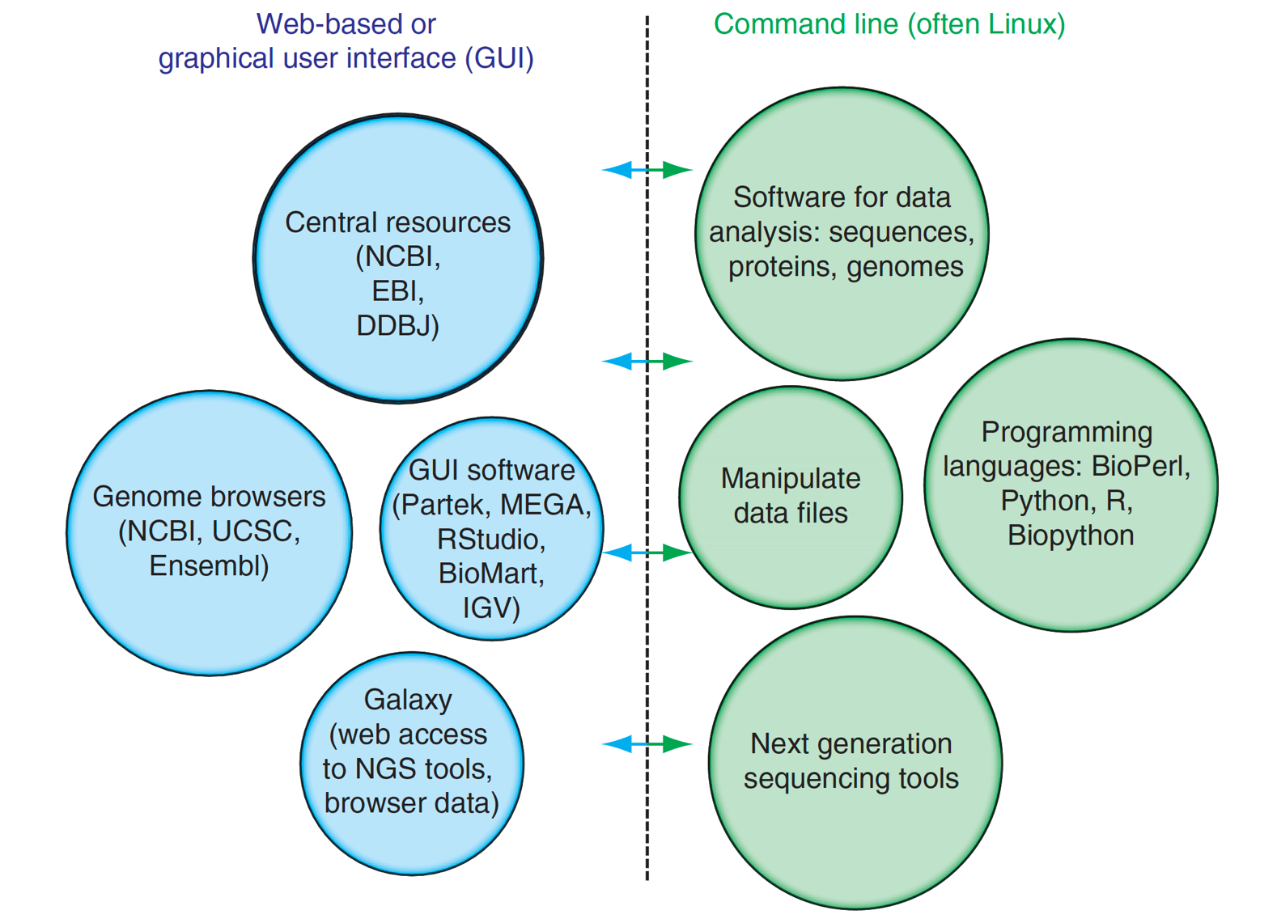
Genomics: Bioinformatics
Analysis and interpretation of genomics data requires:
interfacing with several genomic databases
application of open-source software and statistical packages
programming necessary for data file manipulation, analysis, integration, and data visualization
Pevsner, 3rd Edition (Figure 1.5)

Slide 18

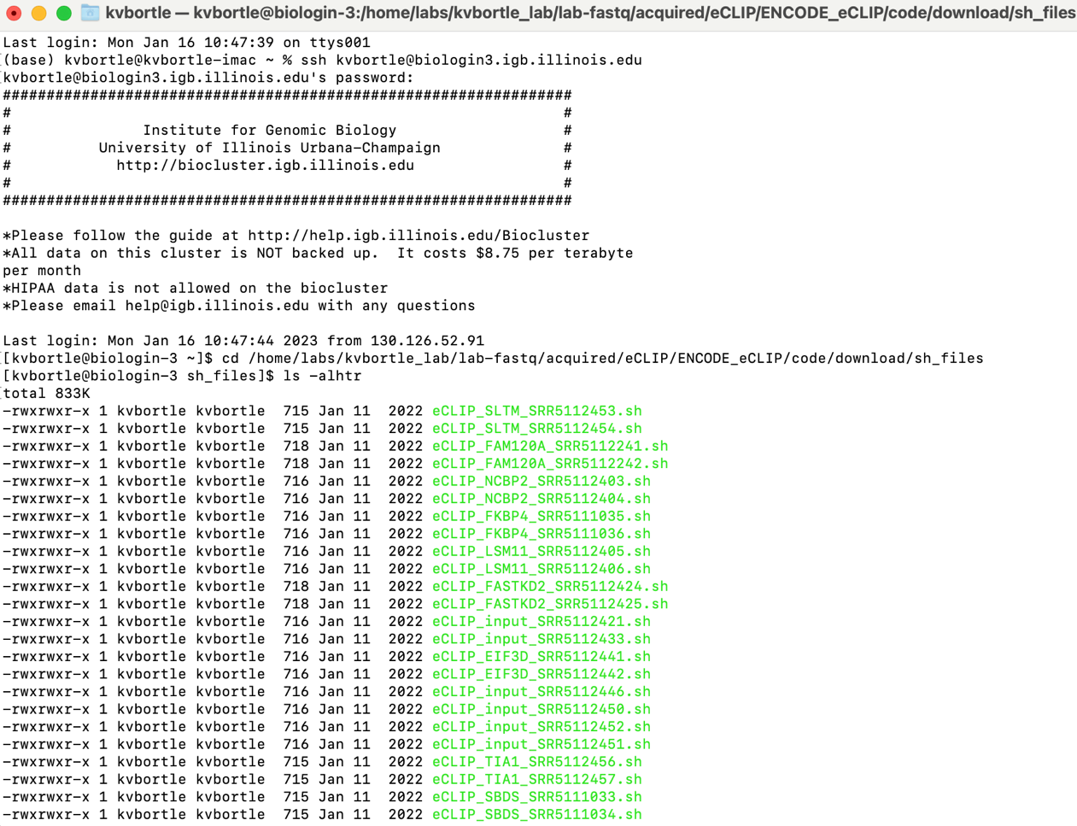
Genomics: Bioinformatics (Linux)
Linux/Unix = operating system with powerful command-line tools
Stable
Efficient
Secure
Portable
Built-in functionality for
complicated tasks (e.g. file
system commands for
processing/analyzing huge
datasets easily and efficiently)

Slide 19

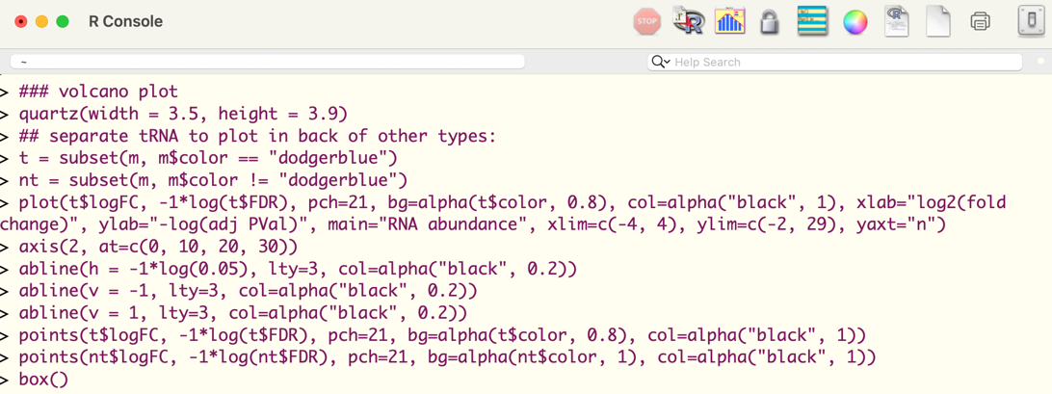
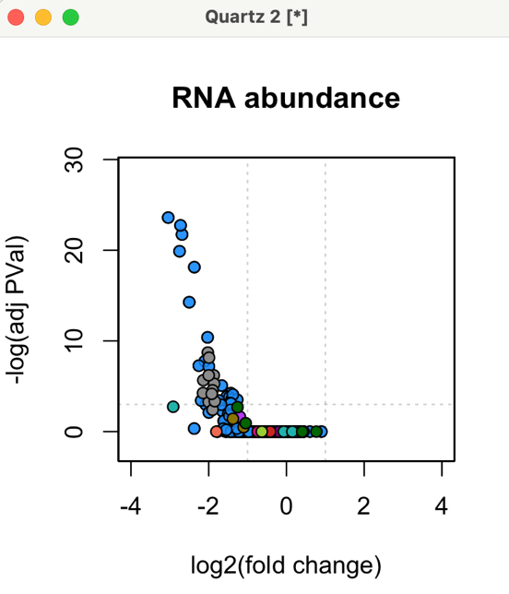
Genomics: Bioinformatics (R program.)
R = programming language for statistical computing and graphics
Open source and cross-platform
Designed for data analysis
Publication quality graphs/figures
Reproducibility
Wide variety of statistical and
graphical tools for analysis and
visualization of genomics data
Active user community extends built-in
capabilities with thousands of packages

Slide 20
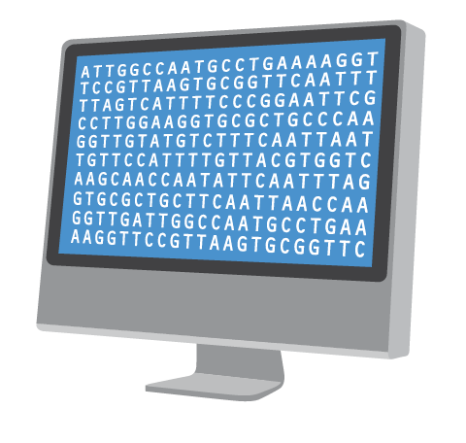
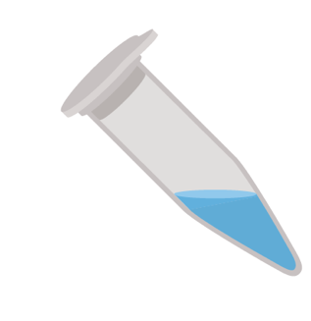
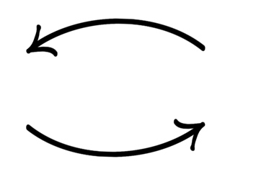
Genomics: Experimental design is critical
Can my experiment answer the biological question I am asking?
method / approach?
number of replicates?
controls?
Internal references, spike-ins?
library quality?
sequencing depth?
Did my experiment work?
Looking at your genomic data is critical

Slide 21
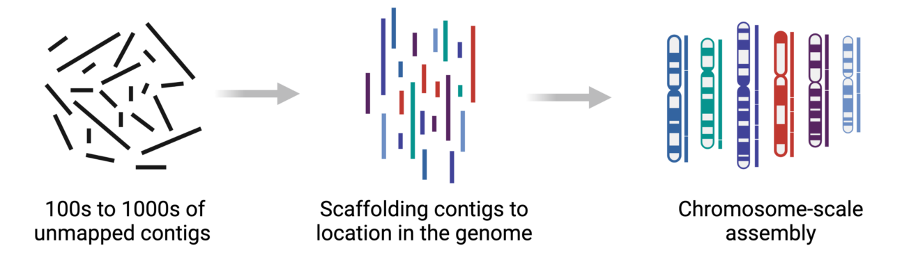
Applications: Genome assembly
Stitching together large numbers of short DNA sequences towards recreating the linear DNA sequences of an organism’s chromosome(s)
https://arimagenomics.com/applications/genome-assembly/

Slide 22
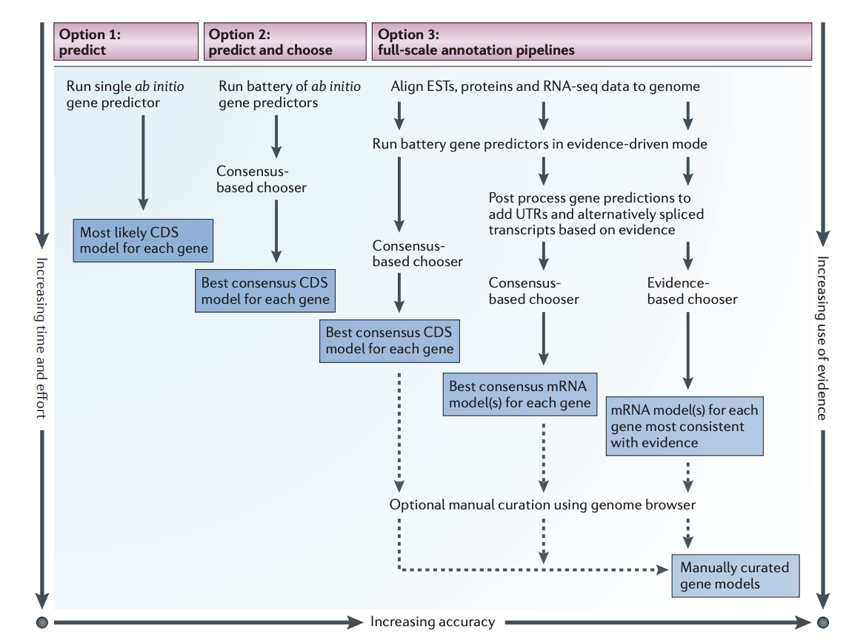
Applications: Genome annotation
Generating a genome “parts list” by attaching biological information:
protein coding genes
origin of replication
pseudogenes
codon usage
rRNAs, tRNAs… ncRNA
gene orientation
intron-exon boundaries
regulatory sequences
repeats
Yandell and Ence, 2012

Slide 23
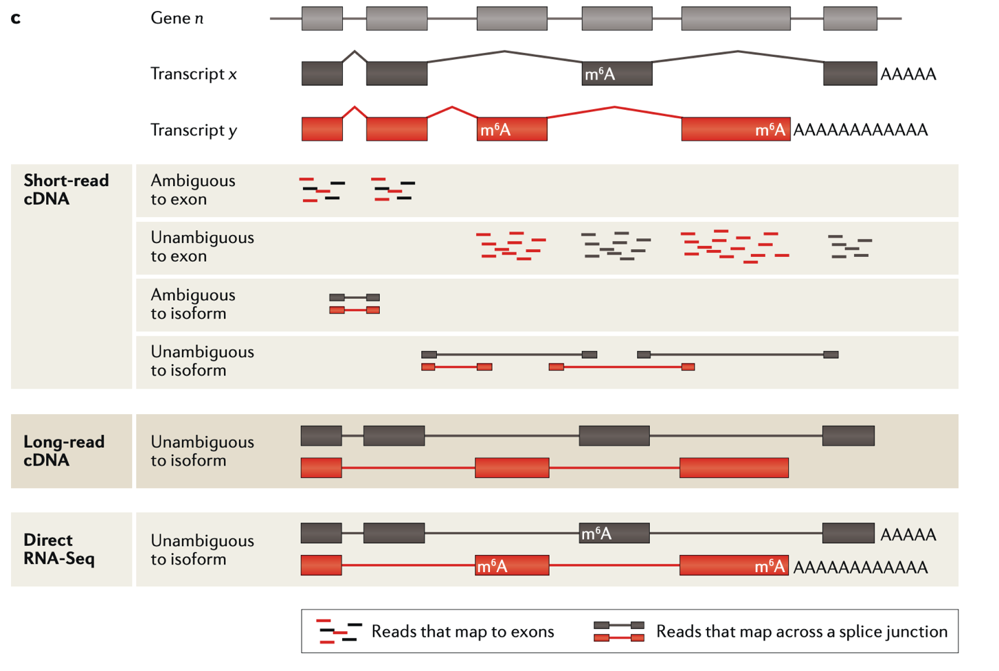
Applications: RNA-sequencing (methods)
Most often used to identify differential gene expression
RNA quality?
steady state or nascent?
which RNA subpopulation?
isoform resolution?
Stark, Grzelak, Hadfield, 2019

Slide 24
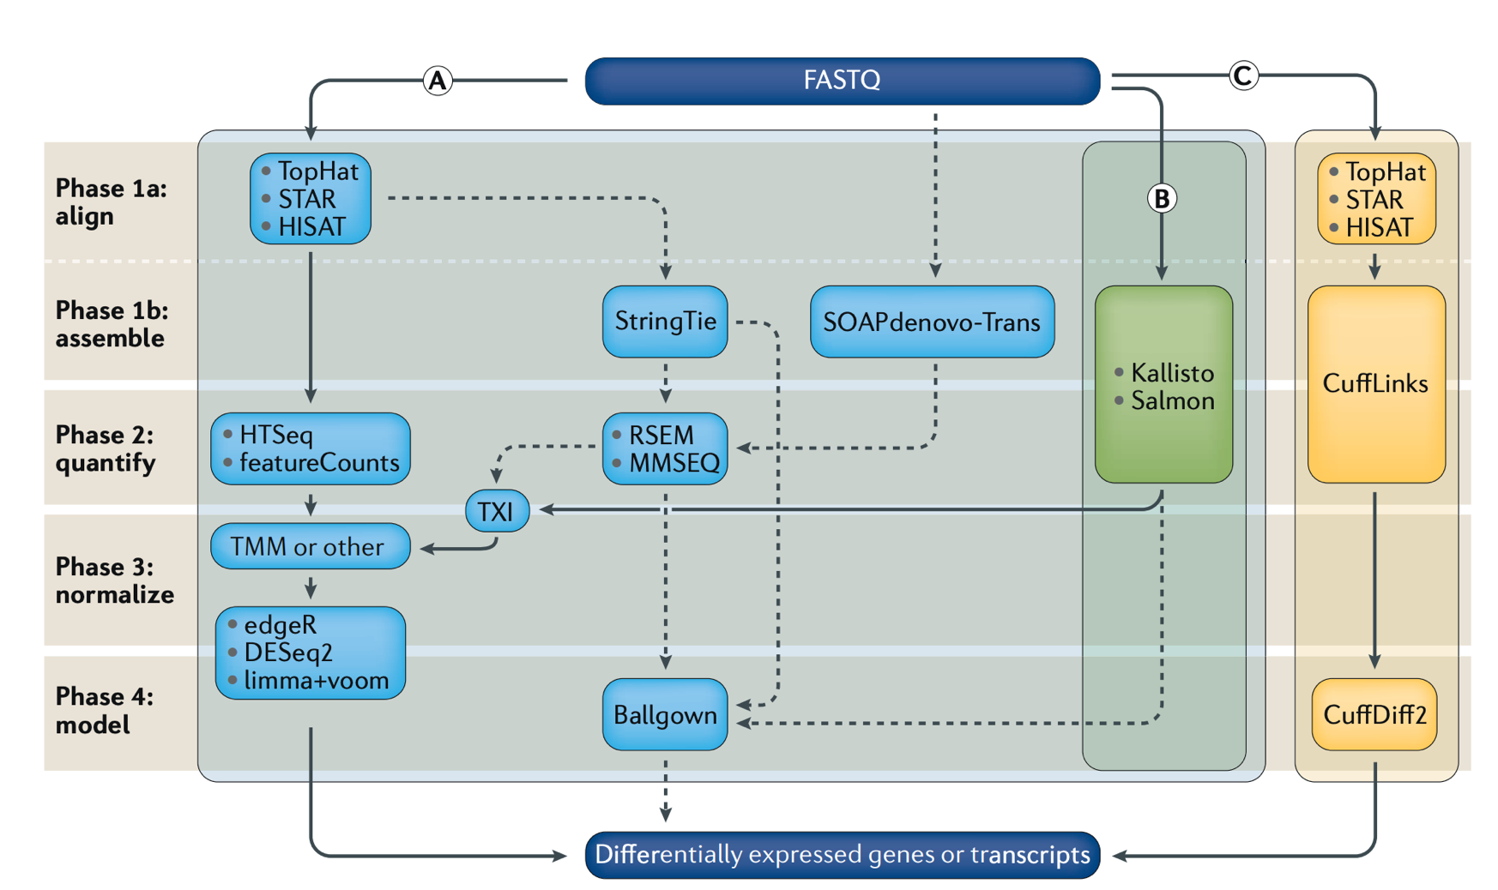
Applications: RNA-sequencing (analysis)
Multiple workflows for
differential gene expression
(same general principles)
read alignment
transcript quantification
filtering / normalization
statistical analysis of differential expression
Stark, Grzelak, Hadfield, 2019

Slide 25

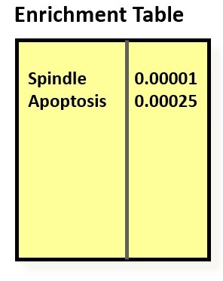
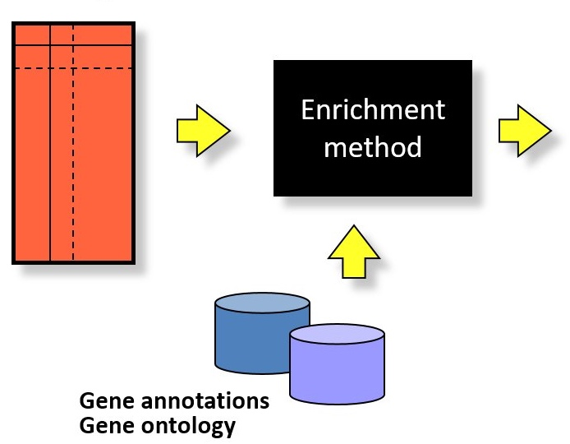
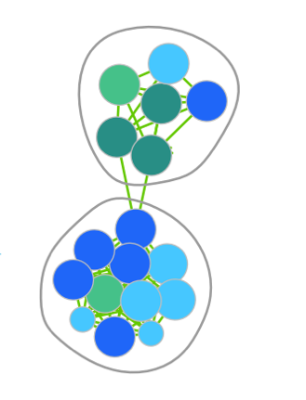
Applications: Functional enrichment analysis
Gene set enrichment analyses identify trends in biological data, e.g. differential gene lists
over-representation analysis (ORA)
functional class scoring (FCS)

Slide 26
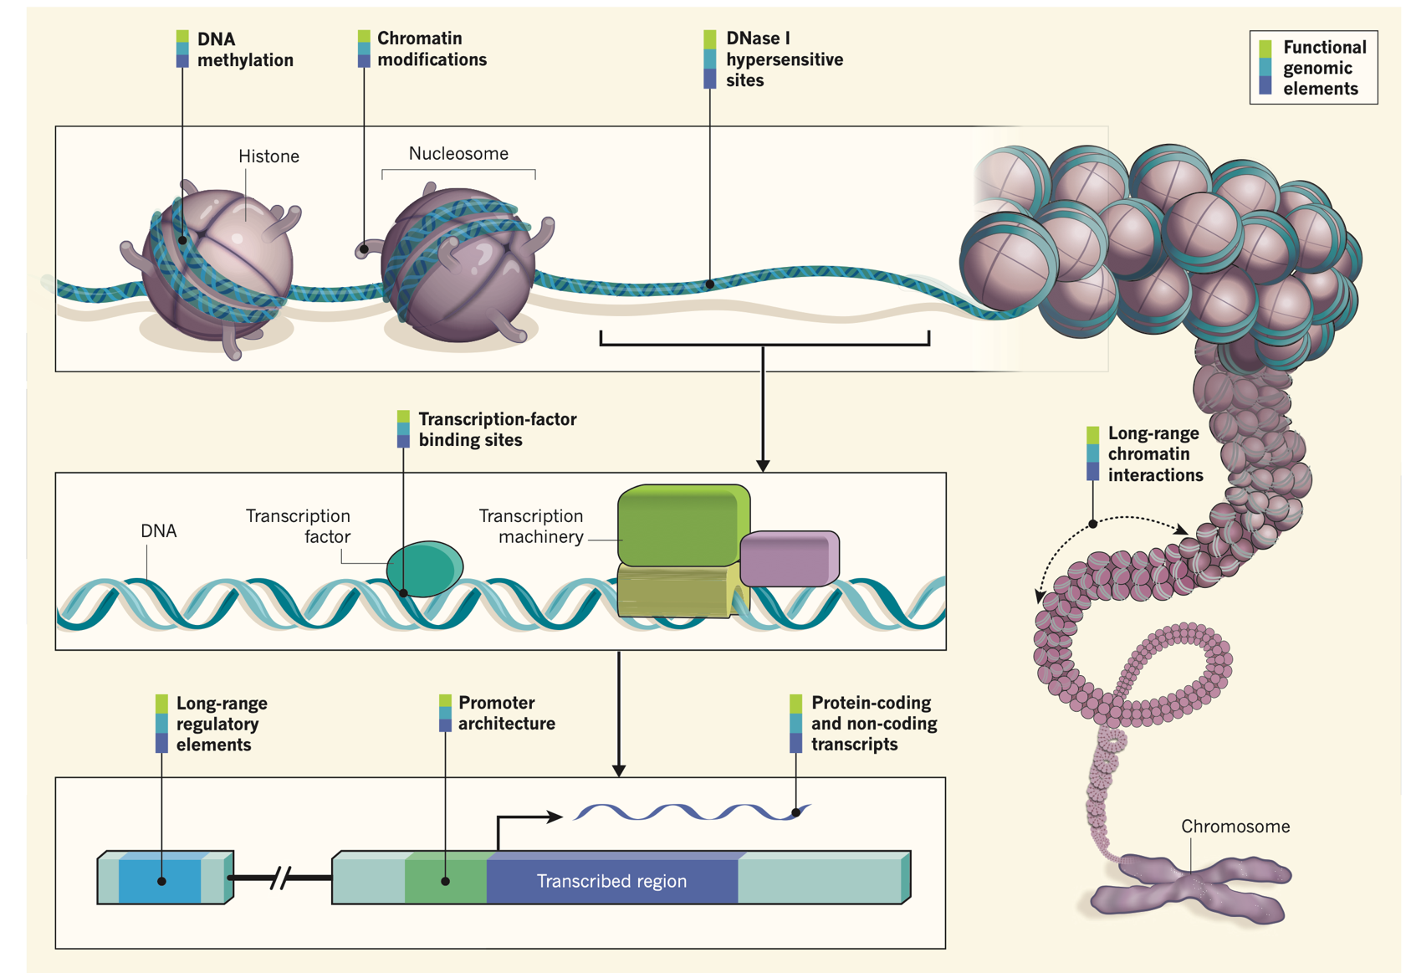
Applications: Epigenome profiling
Transcription factors,
chromatin regulators,
non-coding RNA, and
other gene regulatory
mechanisms
Wendy Bickmore, 2012

Slide 27
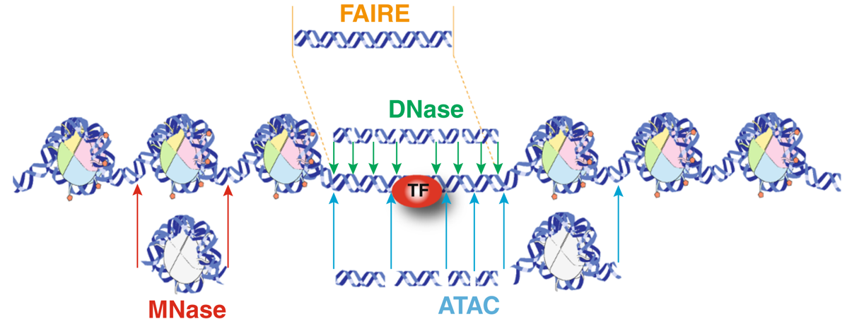
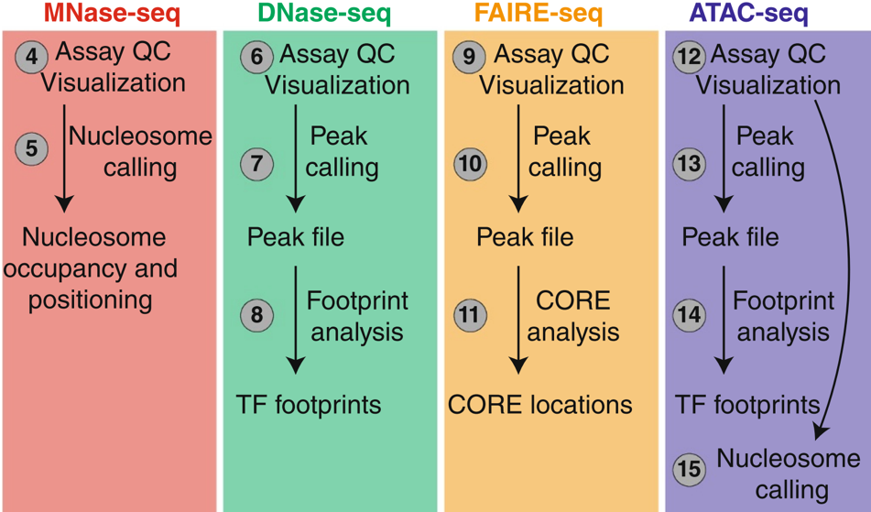
Epigenomics: chromatin accessibility
Regulatory elements coincide with accessible genomic sites. Multiple approaches to enrich for open chromatin determine downstream applications:
accessible peak calling
Nucleosome occupancy and positioning
TF footprinting
custom applications
Tsompana and Buck, 2014

Slide 28
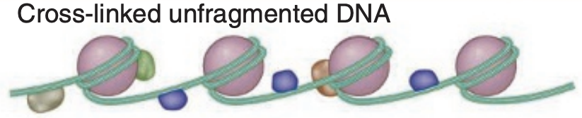
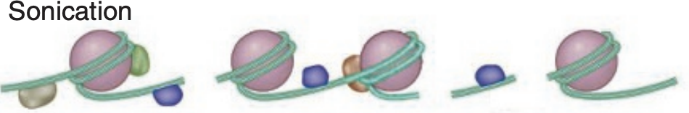
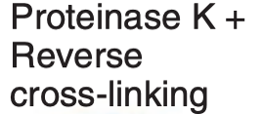


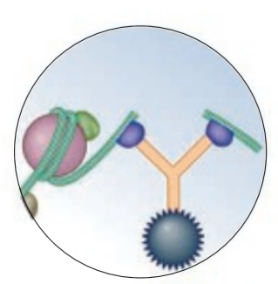
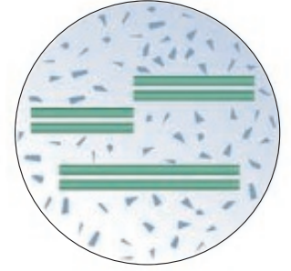

Epigenomics: chromatin immunoprecipitation
Protein-DNA interaction mapping identifies chromatin occupancy of specific proteins, modifications […]
Transcription factor occupancy
Pol II localization
Histone modifications
antibody is critical,
signal-to-noise can be a major issue
CUT&RUN, CUT&TAG
Blecher-Gonen et al., 2012

Slide 29
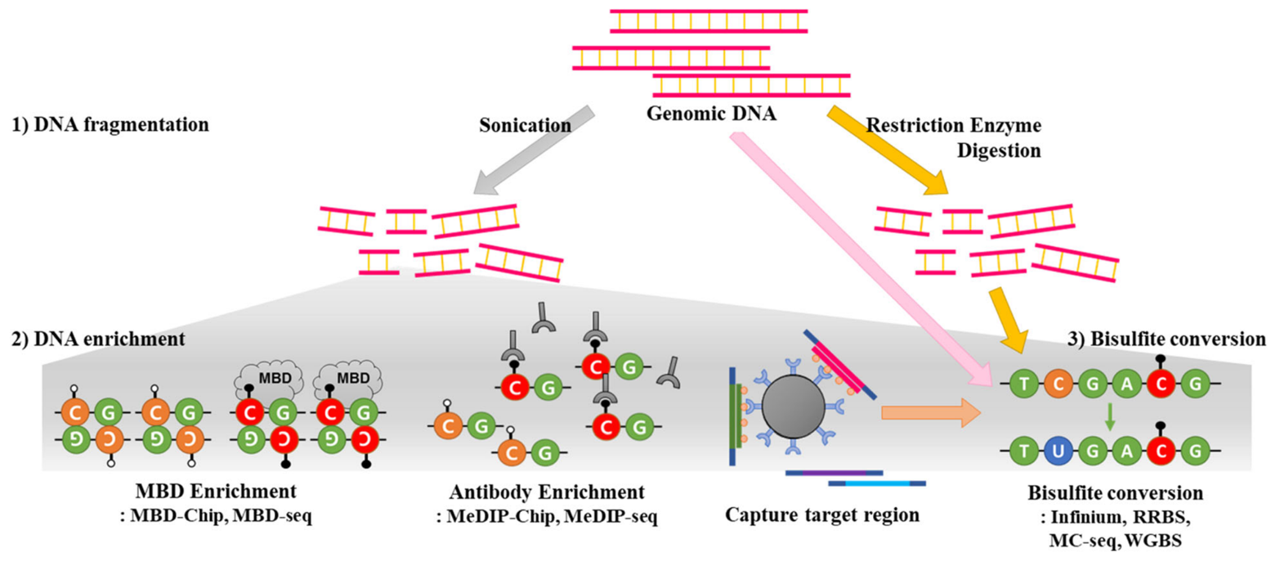

Epigenomics: DNA modifications
Multiple strategies to measure DNA methylation
Bisulfite conversion
Direct detection (seq)
Affinity enrichment
Lee et al., BMC Genomics, 2018

Slide 30
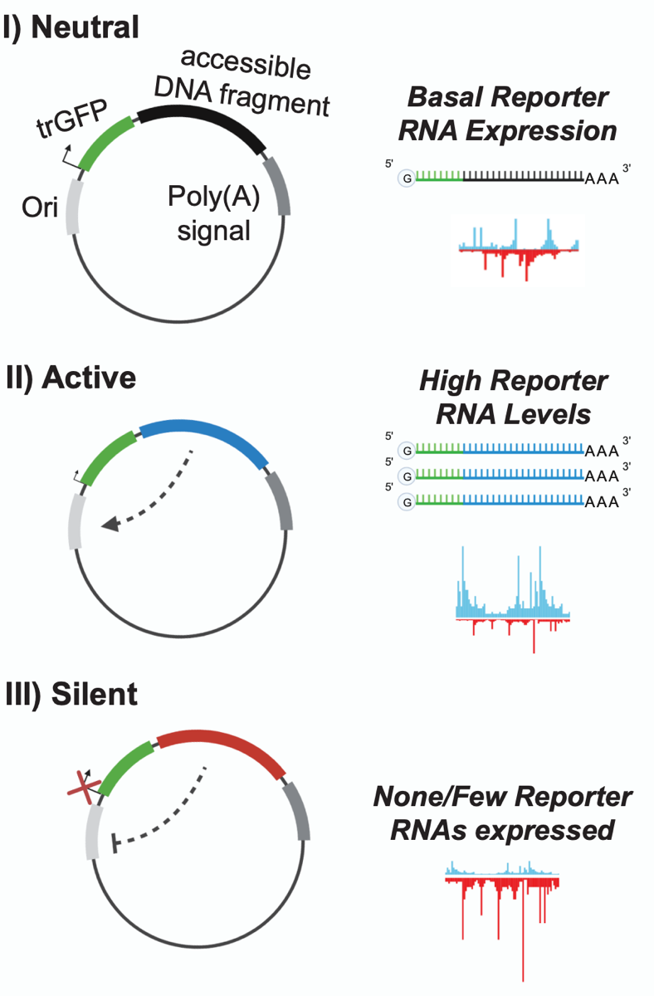
Epigenomics: mapping enhancers and silencers
Reporter-based genomic strategies for identifying DNA elements that either enhance
or suppress RNA abundance
(e.g. STARR-seq)
Hansen & Hodges, 2022

Slide 31
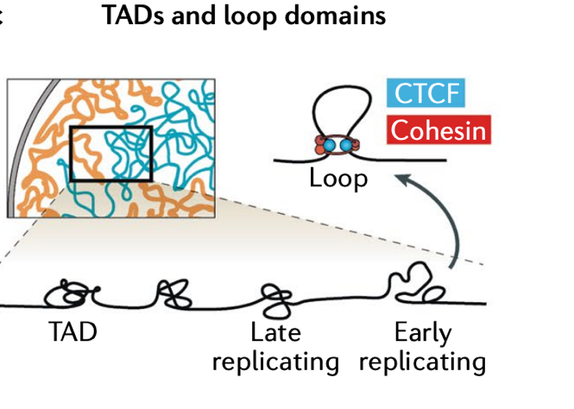
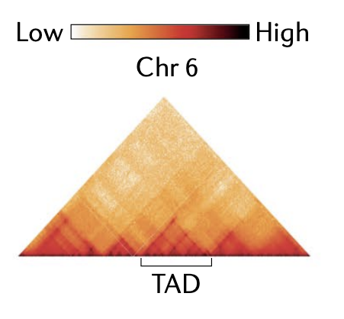
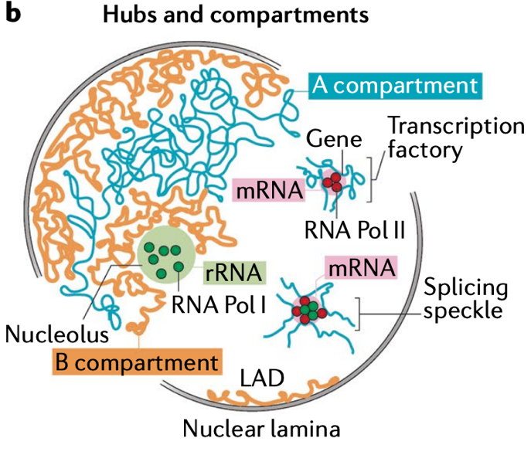
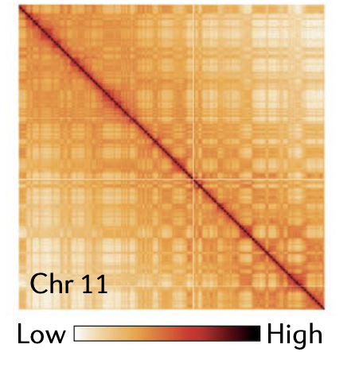
Epigenomics: mapping the 3D genome
Proximity ligation-based chromosome conformation capture strategies (e.g. Hi-C) uncover multiple levels of chromatin architecture
Kempfer & Pombo, 2020

Slide 32
the many modalities of genome function
Integration of multi-omics data is needed to understand the cascade from genetic and disease-associated variants and tissue-specific regulatory mechanisms to molecular and cellular phenotypes
eGTEX, Nature, 2017

Slide 33
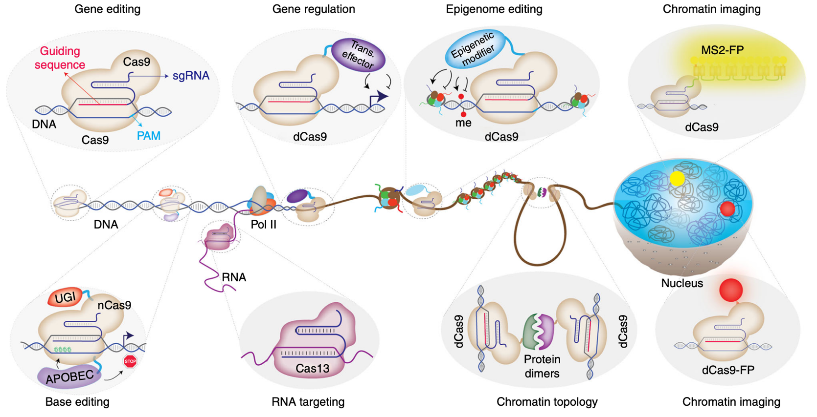
Functional methods: the CRISPR toolkit
Programming CRISPR-Cas9 beyond genome editing:
gene regulation
(activation/silencing)
epigenetic editing
chromatin engineering
RNA targeting
imaging
Adli, Nat. Commun. 2018

Slide 34
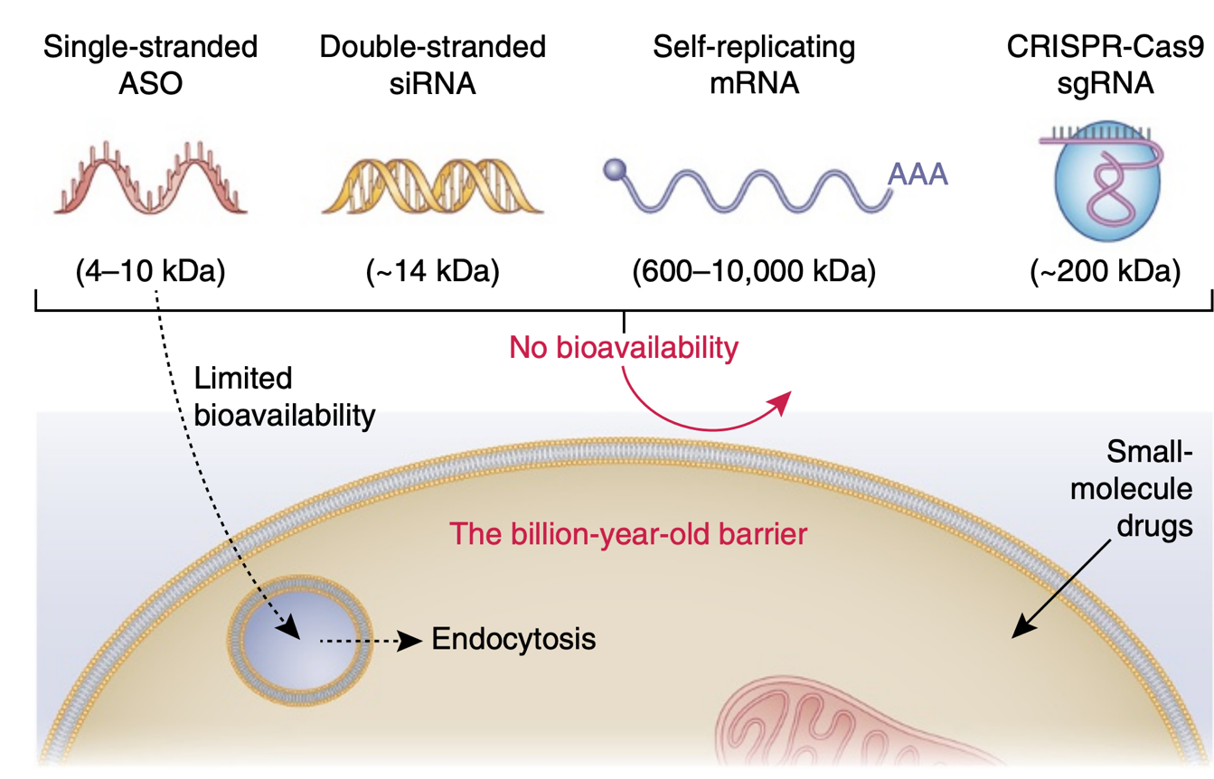
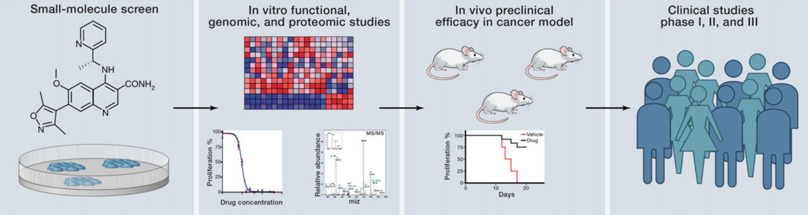
Functional methods: small molecule inhibitors
cell permeable drugs offer rapid method to disrupt transcription, epigenetic modifiers, and “druggable” genes
Dowdy, 2017
Dawson & Kouzarides, 2012

Slide 35
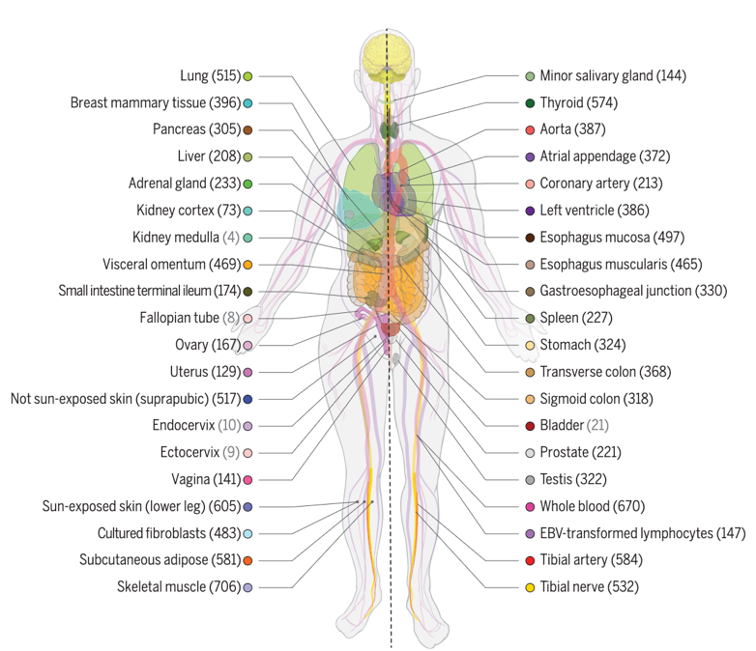
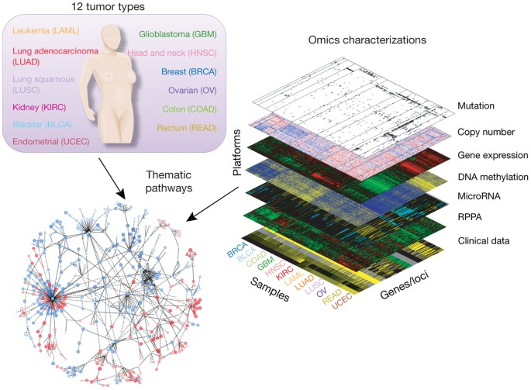
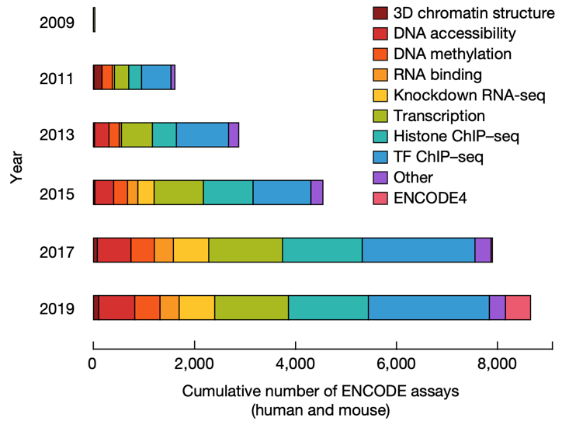
Large-scale genomic databases … the vast data
Encyclopedia of DNA
Elements (ENCODE)
Genotype-Tissue Expression (GTEX)
The Cancer Genome
Atlas (TCGA)

Slide 36
Large-scale genomic databases … the vast data
Multi-omic profiles of
DNA-RNA binding proteins (DRBPs)
CRISPRi RNA-seq + ChIP-seq + eCLIP-seq
Encyclopedia of DNA
Elements (ENCODE)
HNRNPK
HNRNPL
HNRNPUL1
PTBP1
PCBP1
PCBP2
SRSF1
SRSF9
SRSF7
SFPQ
PRPF4
U2AF2
SAFB
SAFB2
MATR3
POLR2G
GT2F1
HLTF
BLAF1
NKRF
RBM15
FUS
EWSR1
TAF15
ZC3H11A
ZC3H8
RBM22 (ZC3H16)
ZNF622
ZNF800
RBM22
NONO
TARDBP
LARP7
KHSRP (FUBP2)
FUBP3
HNRNPK

Slide 37


Our mission: DNA-RNA binding protein exploration
Which genes are sensitive to DRBP silencing?
Are they directly targeted at the DNA and/or RNA level?
How are DRBPs themselves regulated at the gene level?
Hudson & Ortlund, 2014

Slide 38
Course philosophy

Slide 39

Course outline
Part I. Introductions
Genomics
Linux/Biocluster
Sequencing technology
Data retrieval
Programming in R

Slide 40

Course outline
Part II. Application: RNA-seq
Data processing
Differential analysis
Data visualization
Functional enrichment
analysis

Slide 41

Course outline
Part III. Application: Epigenomics (towards function)
Data analysis continued
Multi-omic integration
Interpretation, hypothesis
generation

Slide 42

Course outline
Part IV. Application: Epigenomics (regulation)
Expanded survey
of genomics methods
Integration of epigenomic
data to identify putative
gene regulatory
mechanisms
Synthesis of function and
regulation of DRBPs

Slide 43




Course resources
MCB545 Slack Channel
https://www.slack.com
https://compgenomr.github.io/book/

Slide 44

Course grades, expectations

Slide 45
Is this class for you?

Slide 46
Questions?

